Slide 1
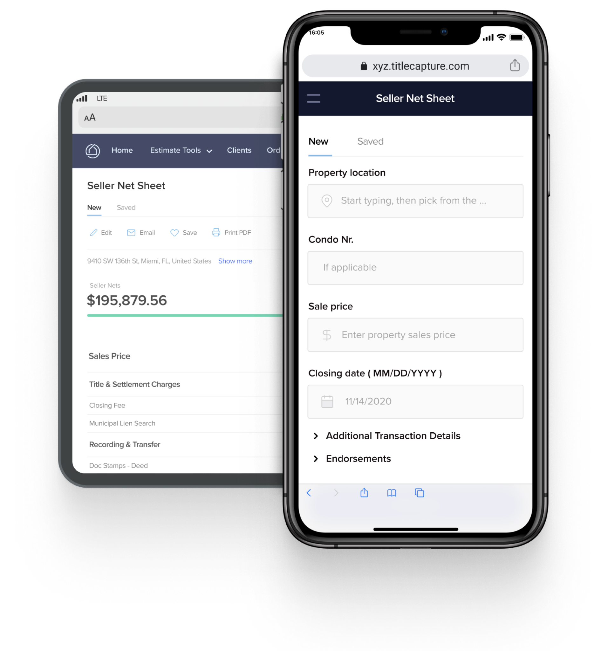
Welcome
askthetitleguy.com
askthetitleguy.com
App Showcase
Title From A New Perspective

Slide 2
Your New Quoting Platform
What this app has to offer:
1. Availability - Access your account and all estimates on our website, on your smartphone, tablet, laptop, and desktop. The cloud- based platform lets you generate estimates 24/7, from any location.
2. Accessibility - No more hanging around for estimates. Whether you're in the office or on the go, simply login to your account and plug in the numbers to share an instant quote with your client.
3. Accurate - With our specific rates and fees built-in, you can trust that any estimate you generate will be identical to one created by your title officer or closer.

Slide 3
What You can do with this Platform
Add Value to your Seller’s and Buyer’s Real Estate Needs using your new platform!
Brand Your Estimates/PDFs
Automate Your Commissions and Seller & Buyer Costs
Generate, Save, Organize and Easily Pull Estimates
Generate Quick Title Quotes
Generate Detailed Buyer Estimates
Generate Instant Seller Net Sheets

Slide 4
Website Login
Visit our website https://askthetitleguy.com and click the
1. ATTG App button
2. No account? Sign up Now button.
Generate a Quote - allows for you to run a quick anonymous quote and find out our closing costs - Email your quote to your clients, just push the Give me a Quote button!
We’d like for you to login to our actual platform and access Net Sheets and pull your estimates!
Just press the Sign up for Free button.

Slide 5
Scan this to find the app and Register

Slide 6
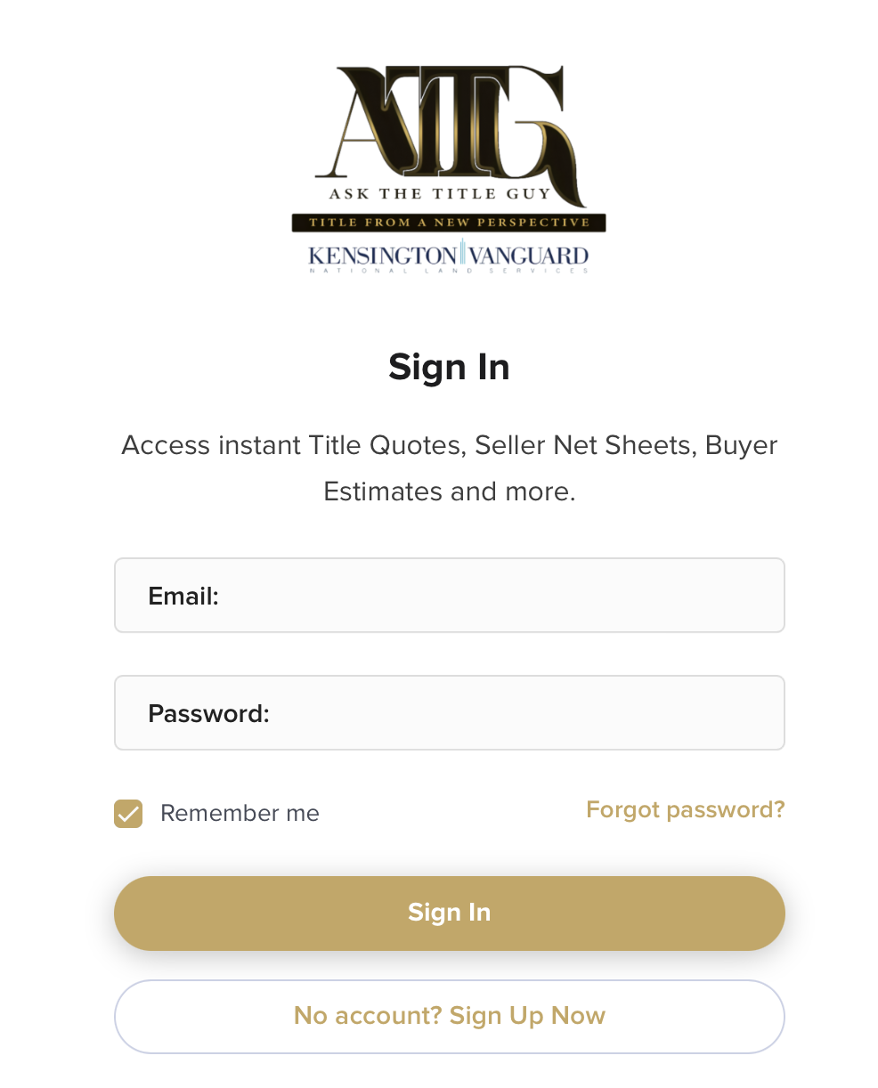
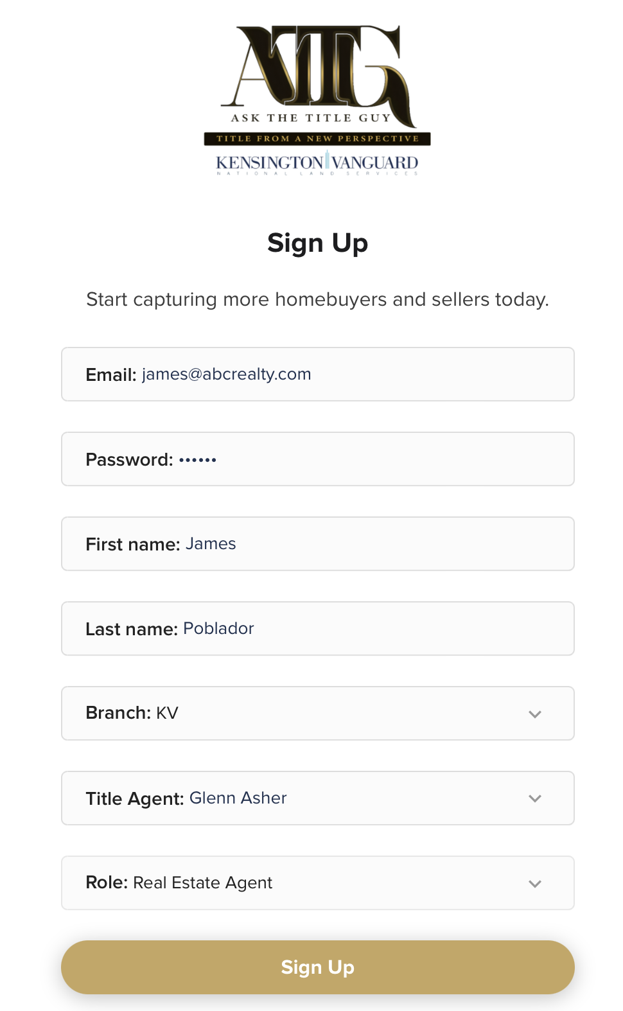
Register
1.
Click the “No Account? Sign up Now” Button
Complete the registration.
Click on Sign up button.
Check your email to confirm.
2.
3.

Slide 7
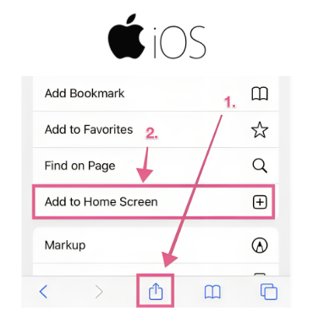
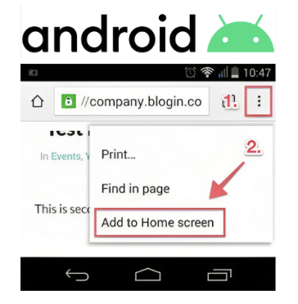
Mobile app
After Scanning the QR Code & Registration
Look for the icons (see images) and click on it if you’re using an iphone (left) and an android phone (right).
Look for “add to home screen” and click it to add the app on your phone
You can also Watch these video clips
Android Users or iOs/iphone Users
Guide: Adding your app to Mobile

Slide 8
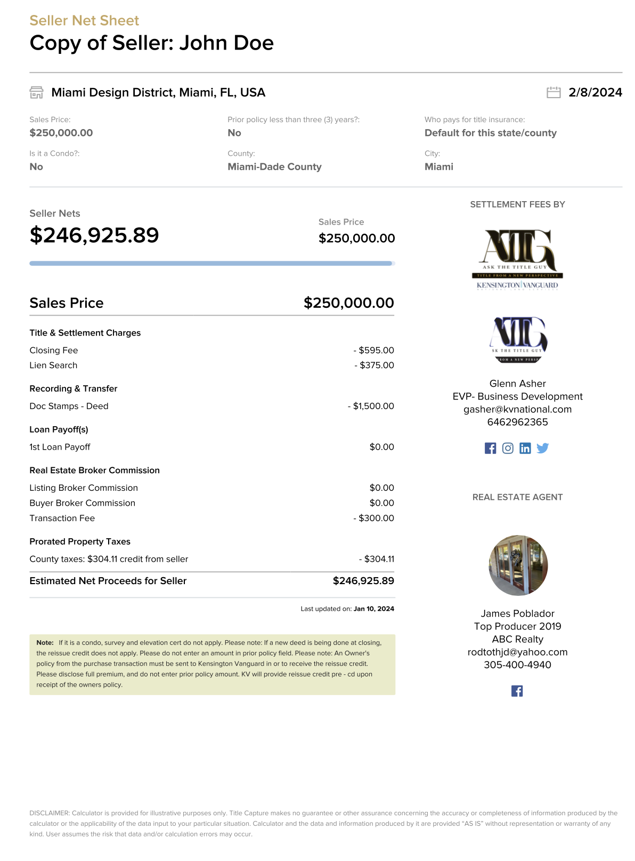
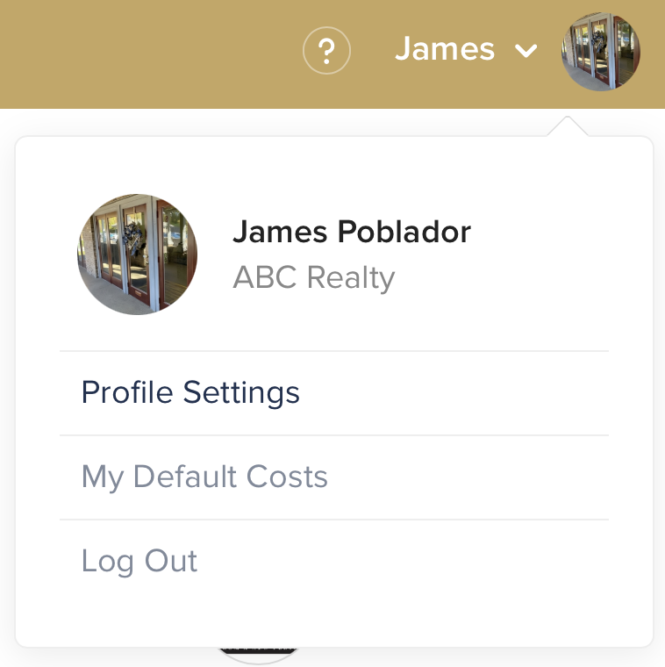
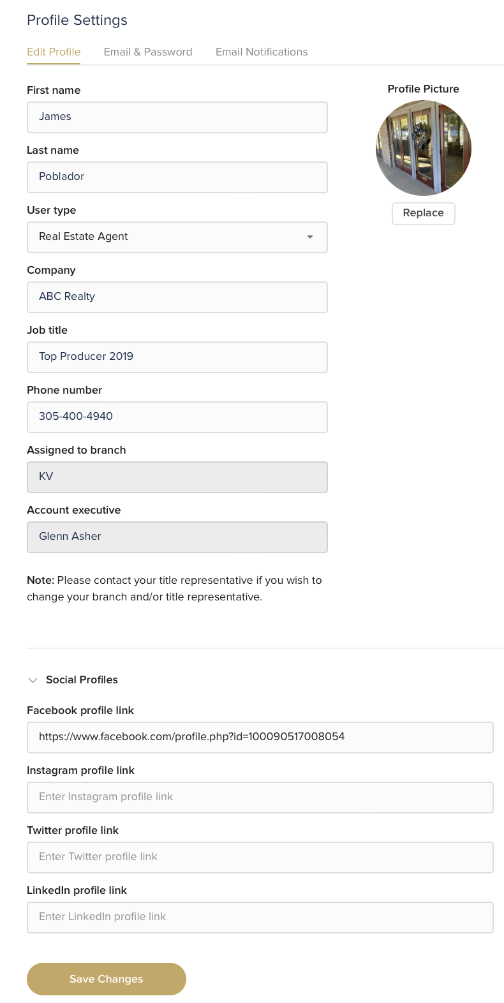
1
Profile Settings
2
Personal Info Tab - Setup your personal info or link your social media accounts to share the platform. Just add your Facebook, Twitter, LinkedIn urls under the Personal Info Tab.
Photo - upload your logo, anything 400 kb or lower or any 300x300 pixels or lower in size and PNG/JPEG format is preferable.
Add your social media links to help share these active links on your PDFs.
Guide: Updating your Profile & Sharing the app
3
4
5

Slide 9
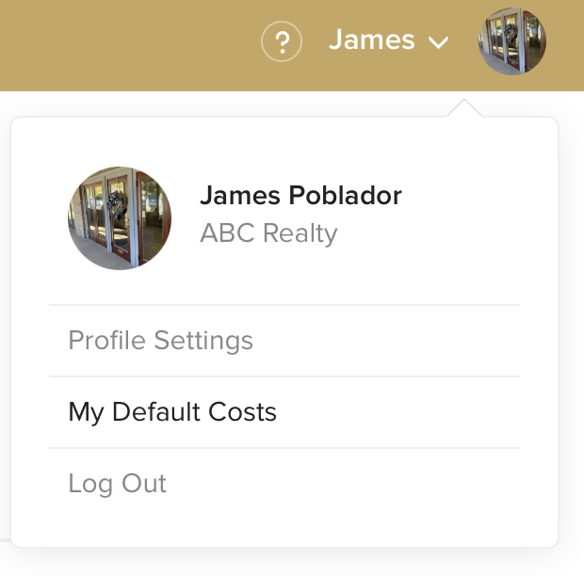
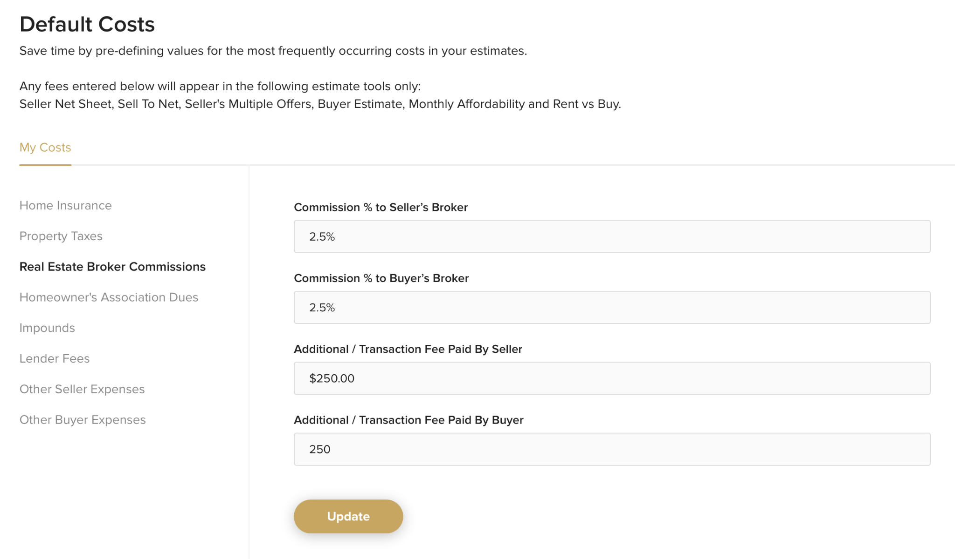
Automate Fees
1
2
Click on your name (top right) then click on My Default Costs.
My Costs - Setup your:
personal commissions,
tax rates, insurance rates,
lender fees,
Additional seller and buyer expenses or credits
Guide: Setting Default Costs
3
4

Slide 10
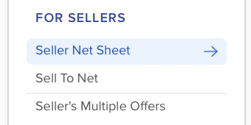
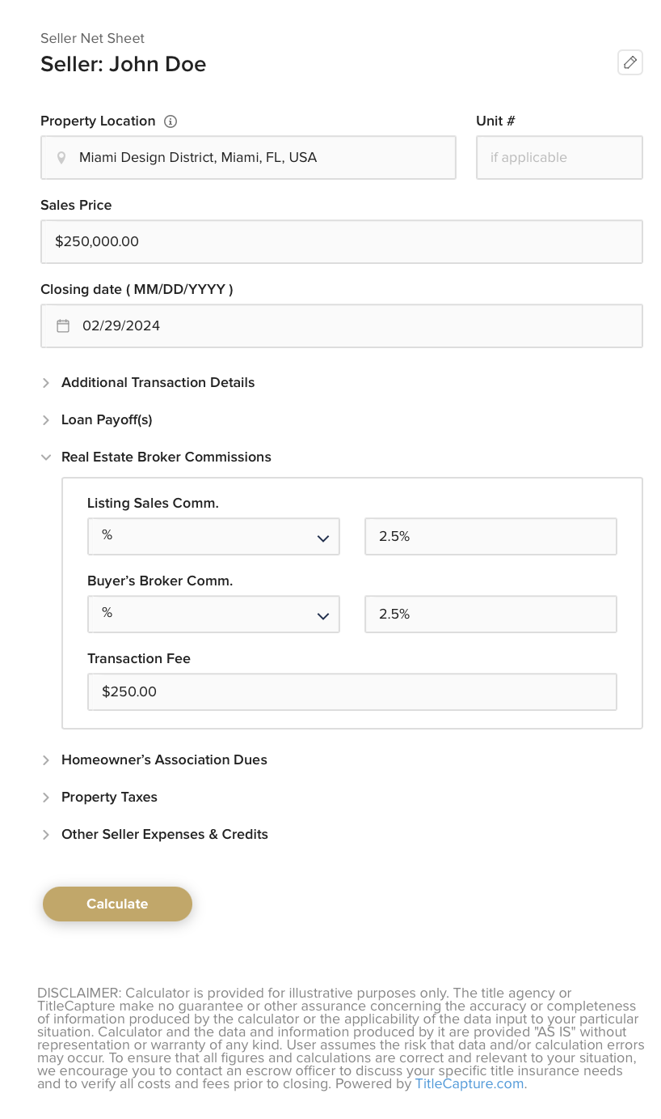
Seller’s Net Sheet
1
2
3
Click on the New Estimate Tab on the left to generate our amazing Seller Net Sheet!
Seller Net Sheet - Plug and Play, allows you to go back easily using our Edit button if you need changes. Email it to your clients or Download its PDF version and attach to your emails. Feel free to even add our Flyers which are perfect for promoting your services and add value to your sellers.
Guide: Generating Seller Net Sheets
4

Slide 11
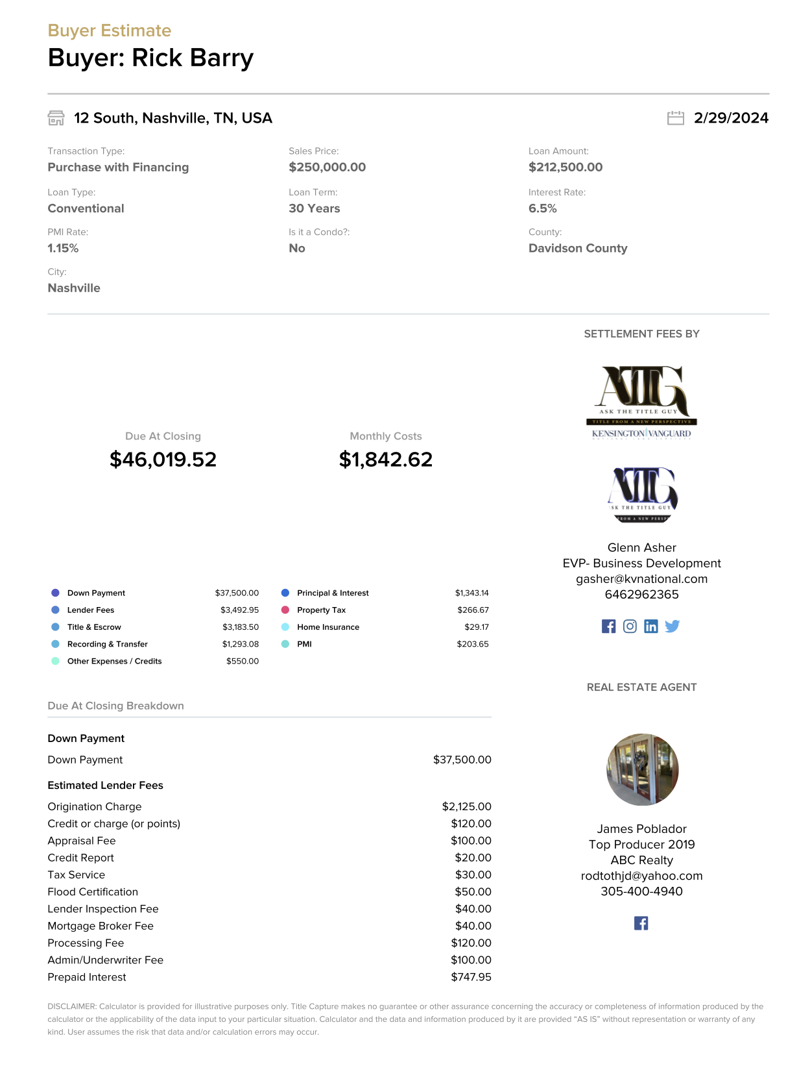
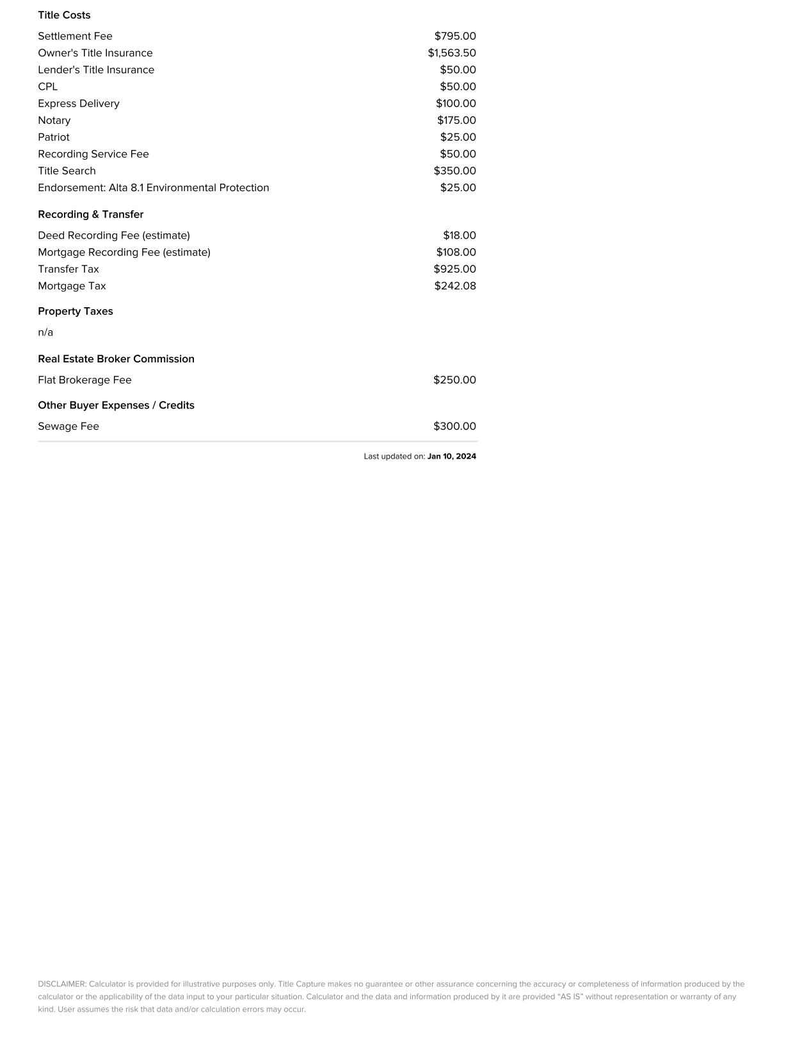
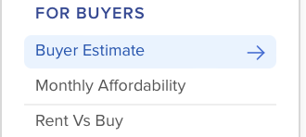
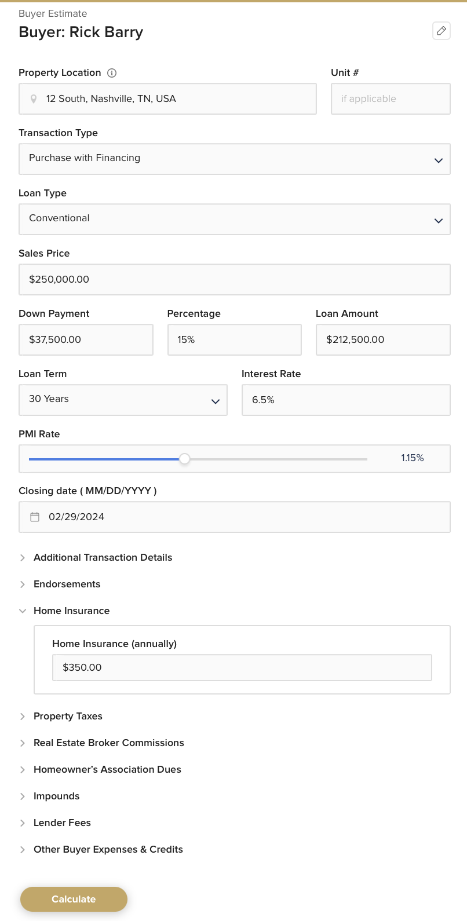
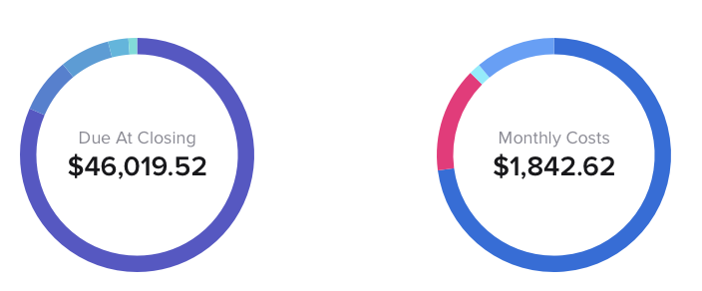
Buyer’s Estimate
1
2
Click on the New Estimate Tab on the left to generate our amazing Buyer Estimate
Buyer Estimate - Plug and Play, allows you to go back easily using our Edit button if you need changes. Email it to your clients or Download its PDF version and attach to your emails. Feel free to even add our Flyers which are perfect for promoting your services and add value to your buyers.
Guide: Generating Buyer Estimates
3
4

Slide 12
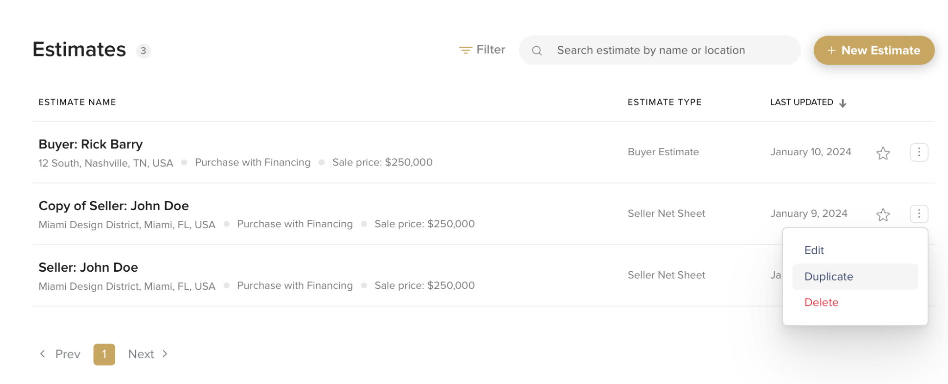
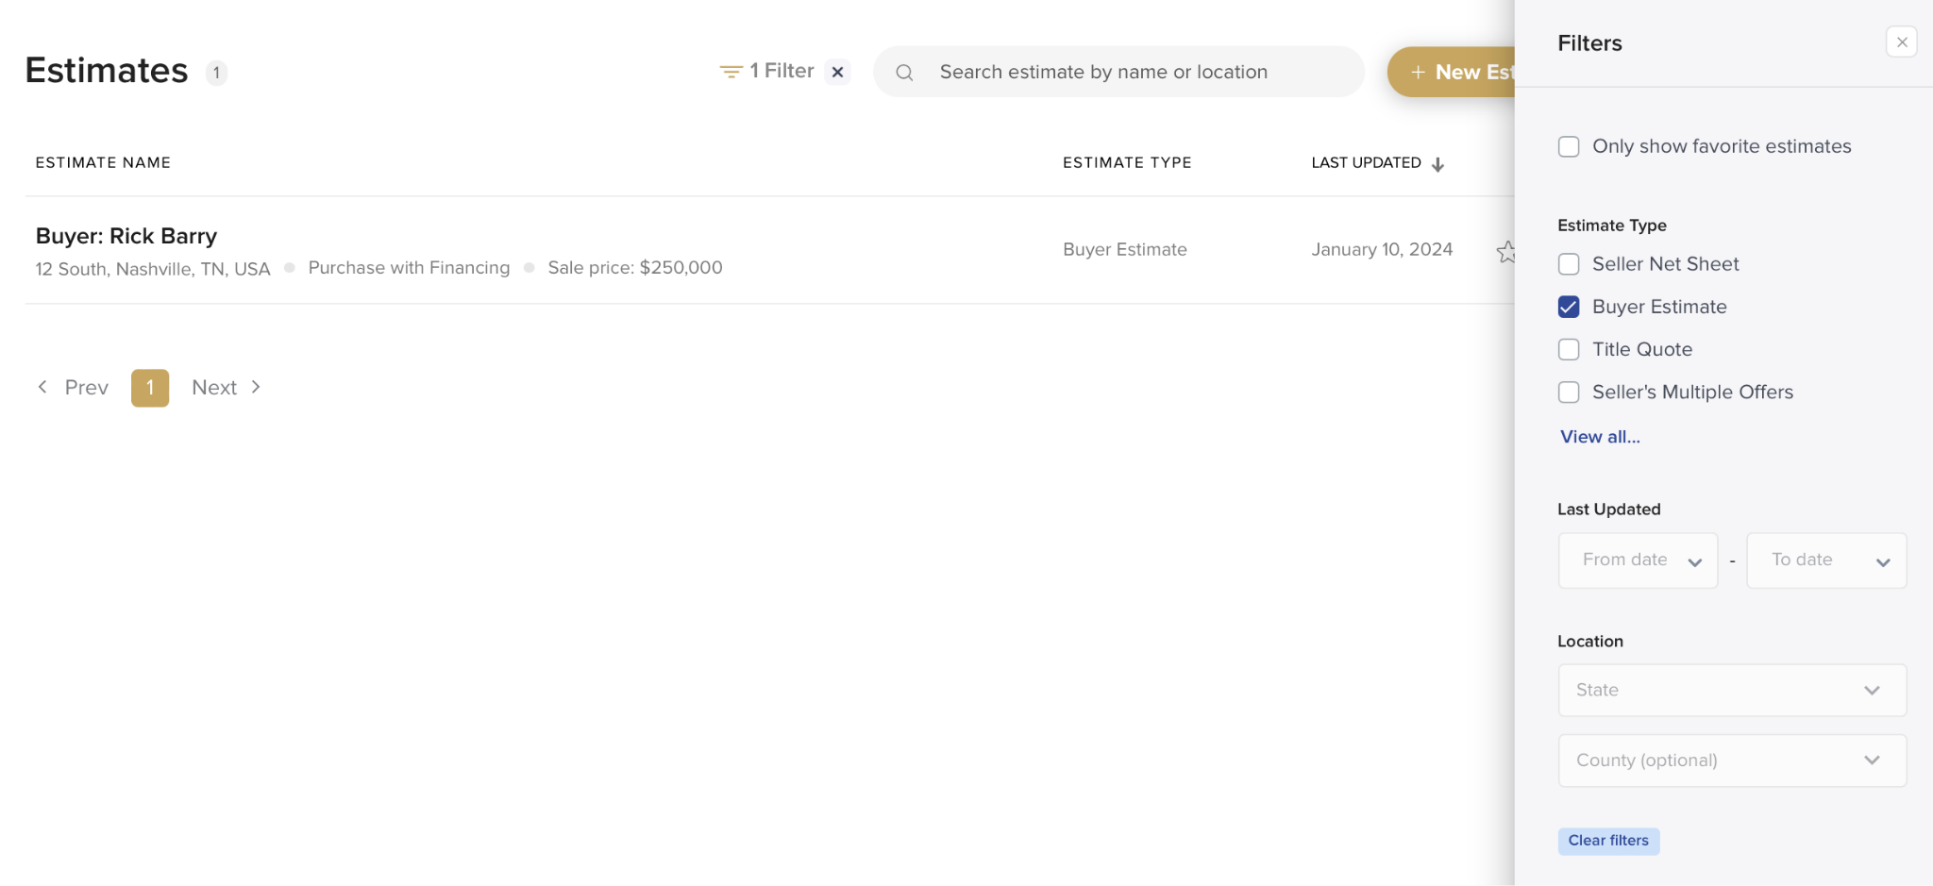
All Estimates
1
Click on the All Estimates Tab on the left to track and manage your estimates
All estimates are automatically saved and you can even generate estimates from the page
You can now edit, duplicate, and compare estimates
Filter - Allows you to search for your estimates, by tool type, by date or by location
Guide: Organizing your Estimates
4
2
3
5

Slide 13
Questions?

Slide 14
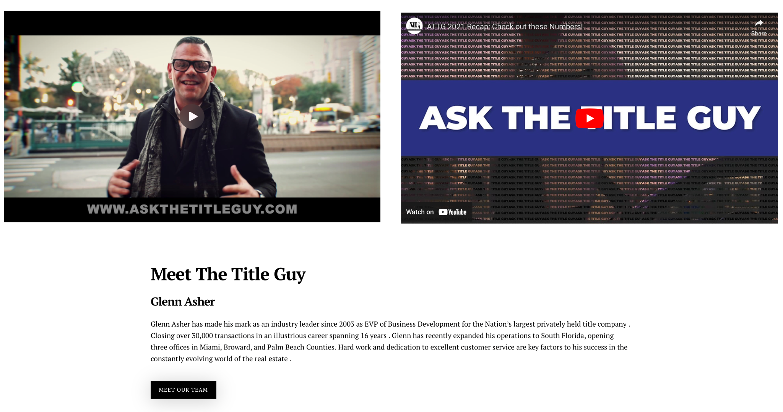
Thank you!
Getting Started Guide for you
Frequently Asked Questions
All About our Team
All About our Services
Contact us!

